Slide 1
Lec - 1

Slide 2



Notes:
NORMAL

Slide 3

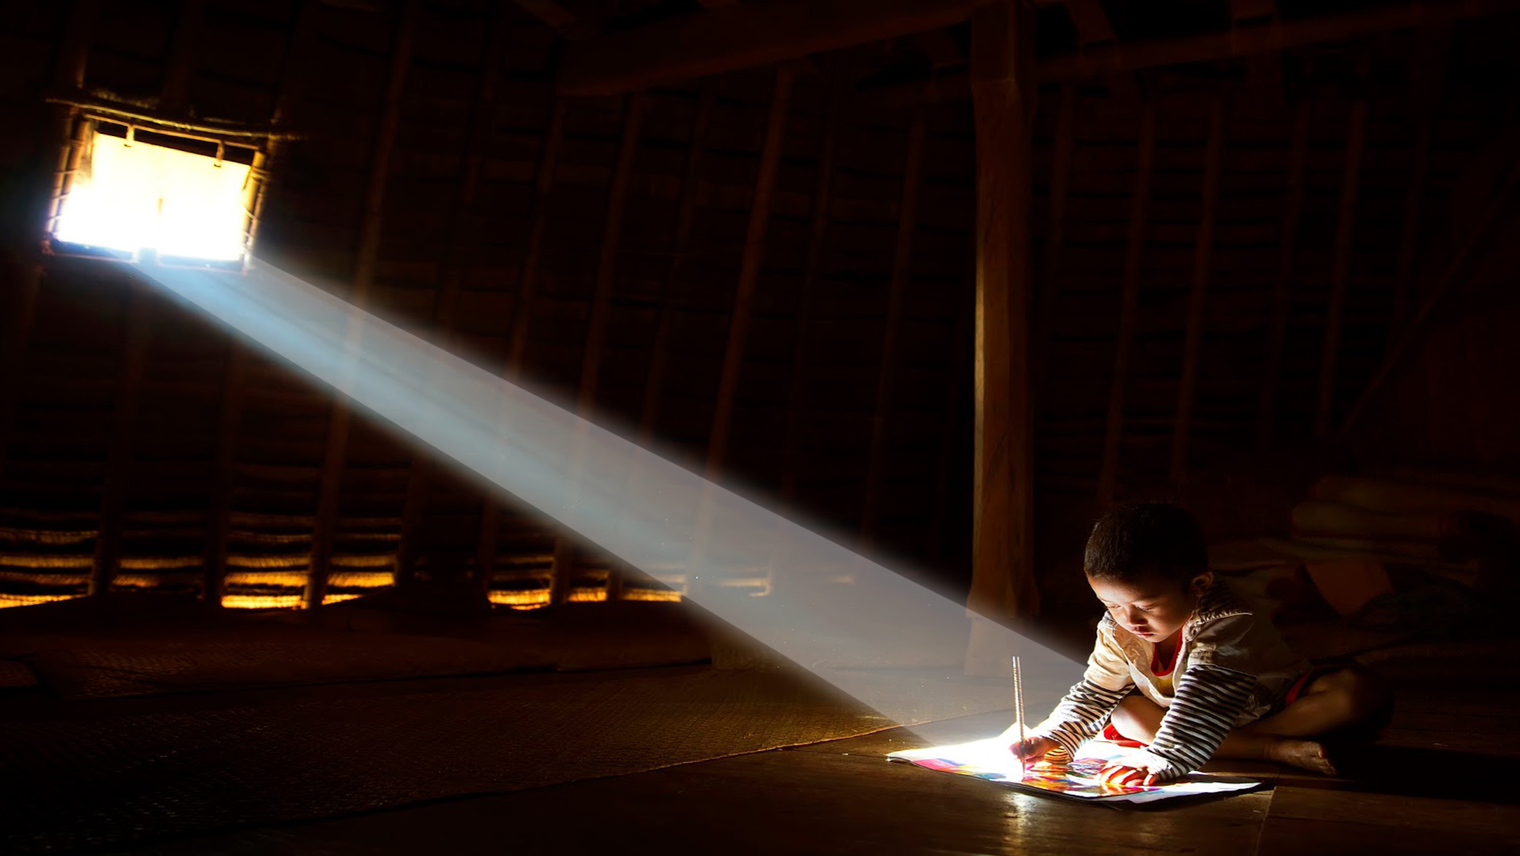



LIGHT
LIGHT
Light is travelling
in a straight line
Light is a form of ENERGY that produces the sensation of vision.
Rectilinear Propagation
Reflection of light
P
Laws of Reflection
i = r
incident ray
1. The angle of incidence is equal to the angle of reflection.
angle of incidence
i
Q
Normal
2. The incident ray, the normal to the mirror at the point of incidence and the reflected ray, all lie in the same plane.
r
angle of reflection
reflected ray
R
Opaque Surface

Slide 4




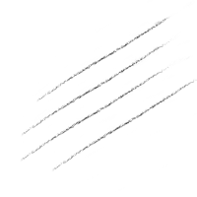
MAKING OF A
PLANE MIRROR
SILVER
Reflecting surface
Opaque surface
REFLECTING SURFACE
Notes:
GREEN

Slide 5


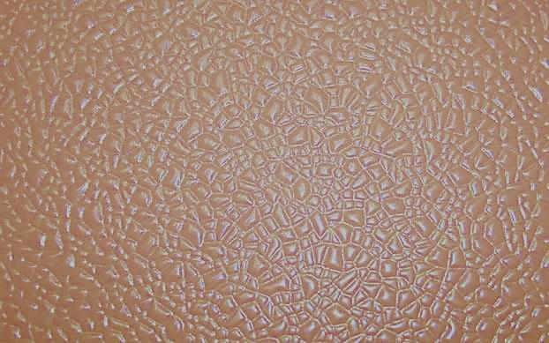
TYPES OF
REFLECTION
REGULAR
REFLECTION
IRREGULAR
REFLECTION
Reflection through smooth surface e.g. Reflection through plain glass, still water etc.
Reflection through rough surface e.g. Reflection through concrete wall, running water etc.
SMOOTH MIRROR
ROUGH SURFACE

Slide 6







CHARACTERISTICS OF THE IMAGE OBTAINED IN A PLANE MIRROR
The image formed in a plane mirror is ERECT and of the SAME SIZE as the object.
1
Image is at the same distance behind the mirror as the object is in front of it.
2
3
Image in a mirror is LATERALLY INVERTED
Notes:
GREEN

Slide 7

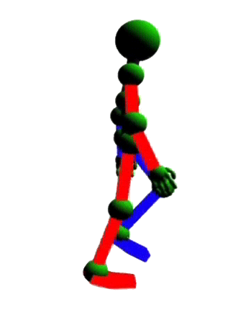
A Robot is standing at a distance 8 m away from a plane mirror
At what distance from him will his image be formed ?
Image is formed at a distance of 16 m from him.
8 m
8 m
16 m

Slide 8
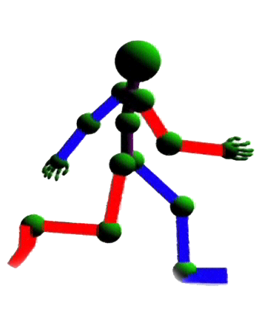
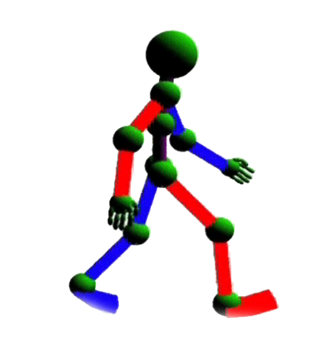
Now if he moves a distance 2 m towards the mirror then,
At what distance will his image be formed ?
Image is formed at a distance of 6 m from the mirror.
6 m
6 m
12 m

Slide 9


SPHERICAL MIRRORS
Convex Mirror
Concave Mirror
CONVEX
CONCAVE
REFLECTING
REFLECTING
Notes:
GREEN

Slide 10
SPHERICAL MIRRORS
Convex Mirror
Concave Mirror
DIVERGING
MIRROR
CONVERGING
MIRROR
Reflecting surface
Opaque surface
Opaque surface
Reflecting surface
Notes:
GREEN

Slide 11


COMMON TERMS
CENTRE OF CURVATURE
The centre of curvature of a mirror is the centre of the sphere of which the mirror is a part.
POLE
Transparent
sphere
The geometric centre of the spherical surface of the mirror is called the pole of the mirror.
C
R
P
PRINCIPAL AXIS
It is a straight line joining the pole of the mirror to its centre of curvature.
RADIUS OF CURVATURE
The radius of curvature of a mirror is the radius of the sphere of which the mirror is a part.

Slide 12

COMMON TERMS
PRINCIPAL FOCUS
Concave mirror
(real focus)
A concave mirror, the reflected rays meet at point F on the principal axis. This point is called the focus of the concave mirror.
P
C
F
Convex mirror
(virtual focus)
A convex mirror the reflected rays do not meet at any point, but the appear to come from a point F on the principal axis, behind the mirror. This point is called the focus of the convex mirror.
f
R
Focal length
The distance of the focus from the pole of the mirror is called the focal length of the mirror.
P
F
C
R
f =
2
f
f

Slide 13
1
Find the focal length of a convex mirror whose radius of curvature is 32 cm.
Given :
Radius of curvature of a convex mirror is 32 cm
To Find :
Focal length (f)
R
Formula :
f =
2
Solution :
R
f =
2
32
f =
2
Focal length of convex mirror is 16 cm
∴ f = 16 cm

Slide 14
2
The focal length of a spherical mirror is 20cm. What is its radius of curvature ?
Given :
Focal length of a spherical mirror is 20 cm
To Find :
Radius of curvature (R) = ?
R
Formula :
f =
2
R
Solution :
f =
2
R =
2 × f
R = 2 × 20
Radius of curvature of spherical mirror is 40 cm
∴ R = 40 cm

Slide 15
Thank You

